Slide 1
TWF Webinar #3 RPS & Slide Decks
Making Effective Calls and Presentations

Slide 2
RPS System Design
This system is designed to create an engaging conversation that allows the prospect to understand how you can help them.
This system is specifically designed to solicit a “no” or “yes” answer.
This format is our reapplication and refinement to our business of the RAPID system designed by Kevin Nations.

Slide 3
Introduction
I believe this is the ONLY part of a conversation that you can truly script.
Your introduction should establish you as an authoritative figure on the Amazon platform.
After the introduction, you can follow the pattern, but have to adapt to make the experience something relevant to them.

Slide 4
Resolve & Set Agenda
This critically important step is one where most people don’t truly establish and take advantage of the process.
You have to resolve the difference of where they are and where they want to be. You have to understand their goals and aspirations.
Setting the agenda provides a VERY powerful transition.

Slide 5
Probe & Educate
Probe until it HURTS!
You have to get at the root of the problem…
THEY NEED YOU!
Their sellers don’t help them, and they DON’T know anything about Amazon.

Slide 6
Solve & Close
Take them to value town. Show their problems, reveal the solution… YOU! The core component here is have confidence in yourself. If you aren’t confident when you speak, you aren’t believable.
Restate your intentions, and CLOSE!

Slide 7
[EXAMPLE SLIDE]
An Online Retail Company
We specialize in the Amazon marketplace to increase the sales and performance of products on Amazon.com
I
[EXAMPLE SLIDE]

Slide 8
Our Company Mission
We strive to be the best online retail company you have ever worked with. Our goal is not to be “just another seller” of your brands and products, but to implement strategies and tactics that will grow your online and in-store sales, perception and brand awareness.

Slide 9
How Do We Do This?
By leveraging our industry leading expertise with the world’s most powerful shopping search engine.

Slide 10
The Science
We create a chain reaction. First, we optimize your product listing on Amazon. This boosts your conversion (AKA - we turn more window shoppers into buyers). Then, we send tons of traffic to those listings using Pay-Per-Click advertising.

Slide 11
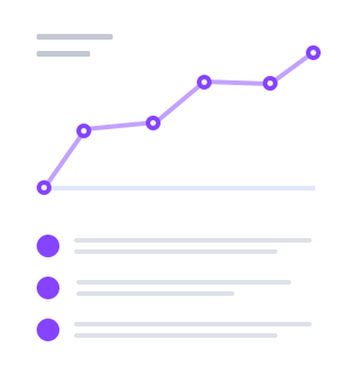
The Result
The increased traffic and increased sales we create will boost your organic search ranks on places like Google and Amazon. This, in turn, grows your brand reach and sales all over the web AND in physical stores too (more on that in a bit). It is rocket fuel for your products.

Slide 12
Summary
The vast majority of shoppers on Amazon will purchase from the top 3 – 5 results when they do a search. We know the magic to make you one of those top results so more people are seeing your product and buying your product. And when you are a top search result on Amazon, it benefits you all over the web and even in physical retail stores.

Slide 13
Types of Amazon Sellers
[EXAMPLE SLIDE]
Leech
PR0
VS
Amazon Seller that sells your products and contributes nothing to improve the sales of the product.
Amazon seller that executes strategies to boost the sales and conversions of products on Amazon.com
Ask Yourself this.. What kind of sellers do you currently have?

Slide 14
Amazon Sales Per Month
Data Gathered using JungleScout.com/estimator
114 Monthly
Your Product Sells Approximately 114 Times per month on Amazon.com
For what we rated as your highest volume search keywords “Organic Dogfood” & “Natural Dogfood” You were the 19th result and 17th result on Amazon.

Slide 15
[NAME OF COMPETITOR]
Data Gathered using JungleScout.com/estimator
504 Monthly
BRAND X Product Sells Approximately 504 Times per month on Amazon.com
This shows that you have a gap of improvement on Amazon that equates to 390 units per month.

Slide 16
Reasons BRAND X is outperforming you
More reviews
More pictures in listing
Better keyword rank
Better Title

Slide 17
What we can do to CRUSH BRAND X
More reviews - Review Software
More pictures in listing – Update listing with more action shots
Better keyword rank – Run PPC campaigns
Better Title – Optimize title

Slide 18
We Estimate That We Could Increase Your Market Share On Amazon By 50% - 100% Over The Next Year

Slide 19
COST TO YOU? $0 In Fact, we will pay you!

Slide 20
End slide show / switch to face to face. Close the deal.

Slide 21
WEBINAR #3 Q/A Post your questions in
the questions box, not in
chat!

