Slide 1
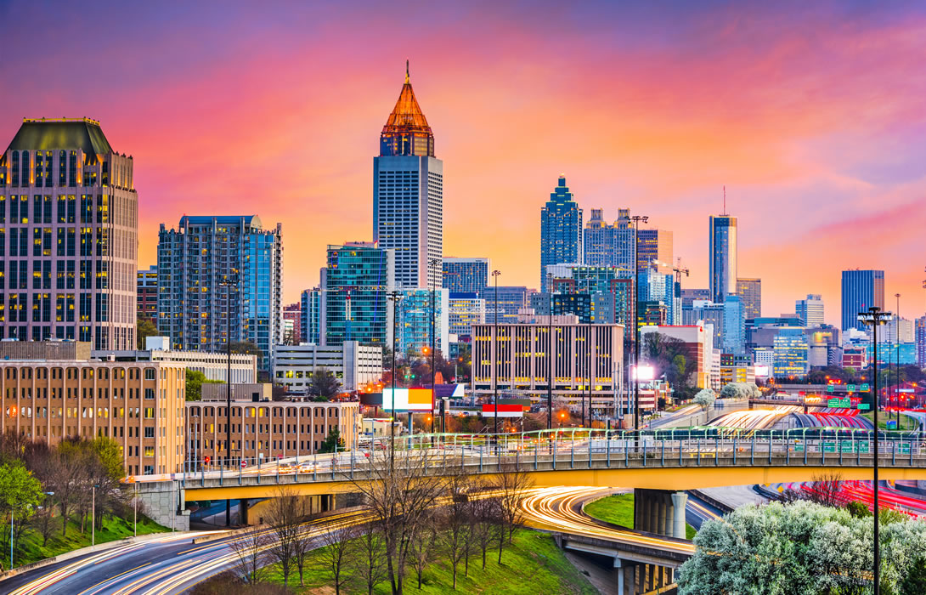
ATL Slide
Welcome to TWF Live 2018

Slide 2
TWF Adventure - Character
Human Missouri, USA Level 2 Retailer
Started Amazon Account 3 Months Ago. Only has 1 active wholesale account.

Slide 3
Choose Your Adventure (product)
The Dragon: 1500 Sales per month. 4 Competitive Sellers. Well optimized listing. Consistent price.
The Cyclops: 600 sales per month. 2 Competitive sellers. Decent listing. Consistent price.
The Goblin: 100 sales per month. 2 Competitive sellers. Poorly optimized listing. Consistent price.

Slide 4
Product Selected - What Next?
Email them
Cold Call them
Research the brand and product

Slide 5
Research Checklist
Photos
Title
Bullets
Description
Responses to listing questions
Responses to negative customer reviews
Compare to more successful competitors
If anyone is running sponsored ads

Slide 6
First Contact Method
Send standard templated email
Send a customized email
Cold call

Slide 7
No Response – Now What
Send email again
Move on
Cold call

Slide 8
Brand Responds – Now What?
Come to call prepared with a gameplan and speaking topics
Be gracious
Build rapport
Have small talk topics already prepared
Resolve
Probe & Educate
Solve

Slide 9
COLD CALL TIME
Have questions prepared
Know their pain points
Know their numbers
Know the numbers of their competitors
Have small talk topics prepared to build rapport
NO PITCHING! Ask questions and be prepared to give value

Slide 10
How to get past the gatekeeper
Develop rapport
Health Report
Ask Questions
Linkedin
Find out who is in charge

Slide 11
THE COLD CALL

Slide 12
Key General Questions To Ask
How do you feel about your current sales volume on Amazon and is it higher than last year?
Did you know that “competitor X” is in the same market and niche as you, but they are selling “Y” more units per year than you?
Do you have a detailed action plan or receive reports on what your Amazon sellers are doing to boost your sales and market share on Amazon?

Slide 13
Key General Questions To Ask
Given how much of an impact Amazon now has on physical retail sales thanks to people being able to easily pull out their phone and do research on Amazon, do you feel like your Amazon content is telling your brand story in the way that you want it to?
How much in gross profit are your current seller re-investing back into Amazon advertising?

Slide 14
ATL Slide

